Slide 1
Learning for Wednesday 21st October
Year One

Slide 2
Early Bird Phonics
Handwriting: Practise writing these letters
i l t u r
n m h b p

Slide 3
Maths – Maths in Minutes
https://www.topmarks.co.uk/learning-to-count/paint-the-squares
Can we count forwards to 100?
What happens to the numbers when we count forwards? Backwards?
Can you count from a given number?

Slide 4
Have a look at this numberline.
What does it show? What do the numbers go up in? How can this help you count?
0
1
2
3
4
5
6
7
8
9
10

Slide 5
Fluency
What does the number line show?
0
1
2
3
4
5
6
7
8
9
10
6

Slide 6
Fluency
Complete the number line.
0
1
2
3
4
5
6
7
8
9
10

Slide 7
Fluency
Put a circle around the smallest number.
Put an arrow pointing to a number between 3 and 7.
Underline a number between 5 and 9.
Colour the third number.
0
1
2
2
3
4
5
6
7
8
9
10

Slide 8
Fluency
Put a circle around the second number.
Put an arrow pointing to a number between 6 and 10.
Underline a number between 2 and 6.
Colour the greatest number.
0
1
2
3
4
5
6
7
8
9
10
10

Slide 9
Fluency
Put a circle around the 6th number.
Put an arrow pointing to a number between 4 and 8.
Underline a number between 1 and 5.
Colour a number less than 1.
0
0
1
2
3
4
5
6
7
8
9
10

Slide 10
Fluency
Where would the following numbers go on the number line?
4
7
2
0
2
4
5
7
10

Slide 11
Reasoning
Tick (✓) true or false next to each statement.
0
1
2
3
4
5
6
7
8
9
10
Statement | True | False
One less than 6 is 5.
One more than 7 is 8.
Three is greater than 4.
9 is equal to 9.
6 is less than five.

Slide 12
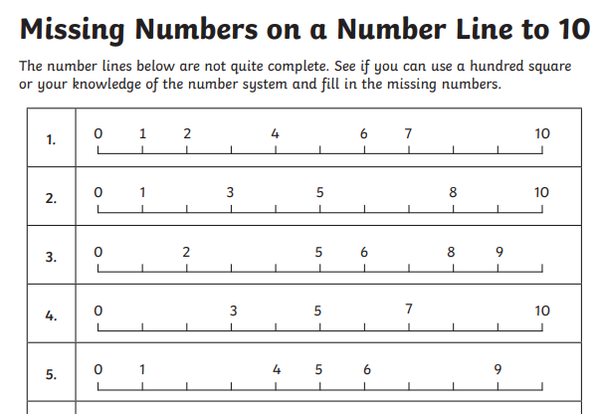
Missing numbers worksheet (find it on the blog)

Slide 13
Phonics
Recap Phase 2 and 3 sounds
Phonics Play – Flashcards
Log in:
Username: school
Password: meadow
Tricky word song:
https://www.youtube.com/watch?v=R087lYrRpgY

Slide 14
Revisit: Yesterday we learned the ‘ear’ trigraph, like in ‘hear’.
ear
What words can you think of that have this trigraph?

Slide 15
ear
hear
dear
tear
near
ear
beard

Slide 16
New sound of the day!
air
Our new trigraph is /air/ like in ‘hair’.

Slide 17
air
air
pair
fair
hair
lair
Write these words and add the sound buttons.

Slide 18
Buried Treasure: https://www.phonicsplay.co.uk/resources/phase/2/buried-treasure
air

Slide 19
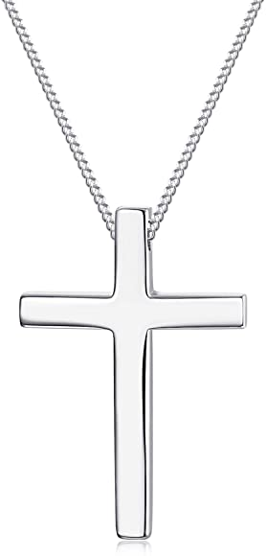
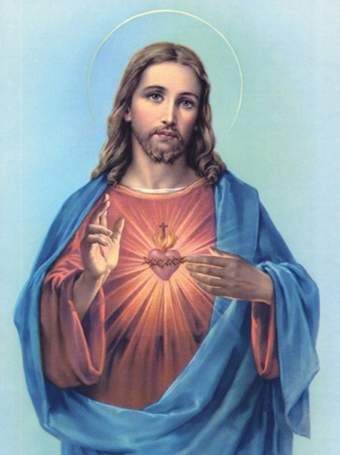
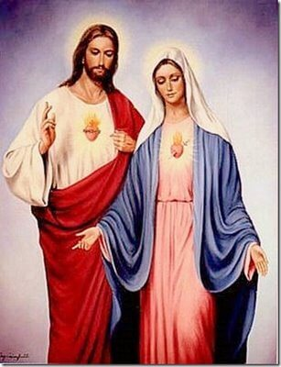
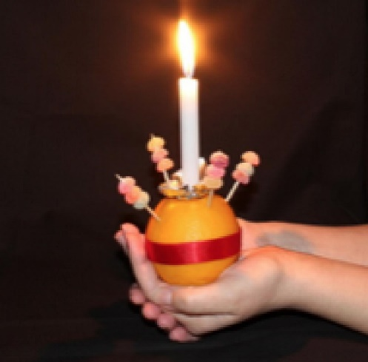
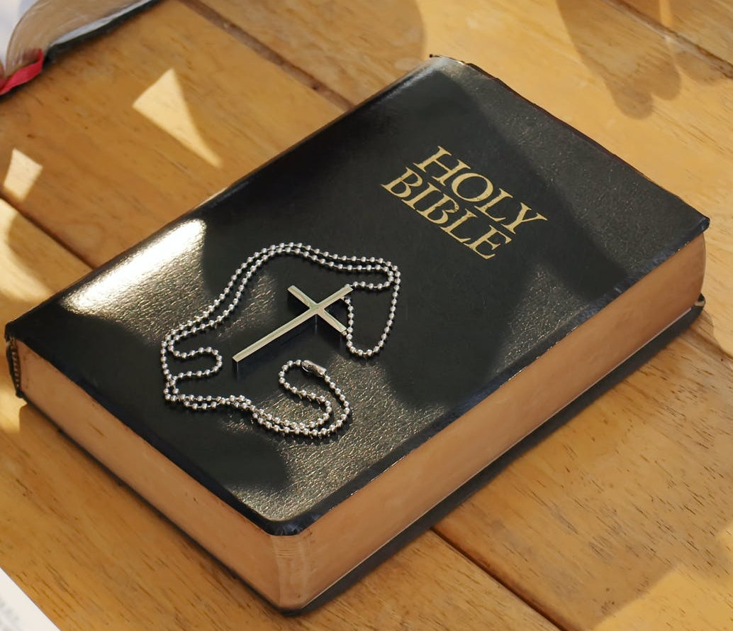
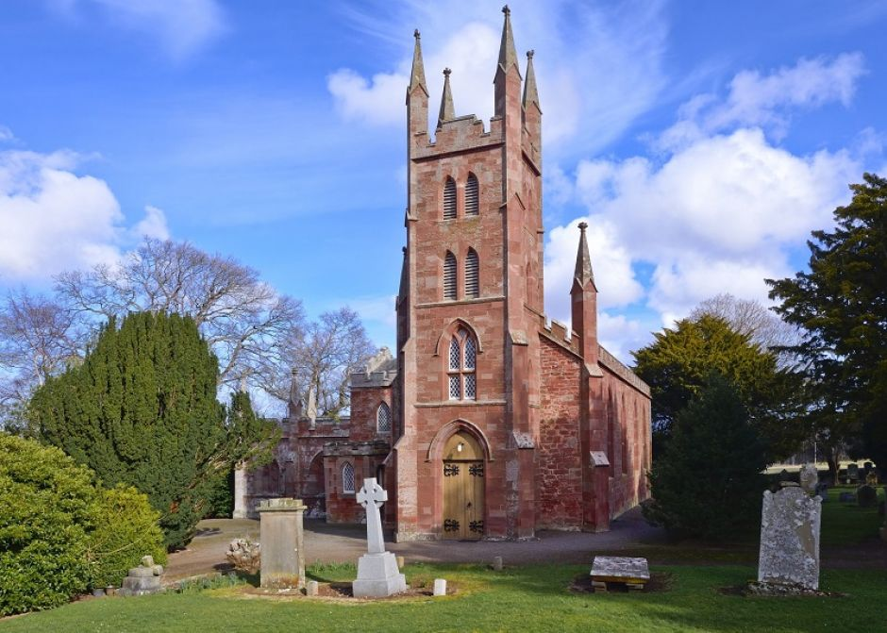
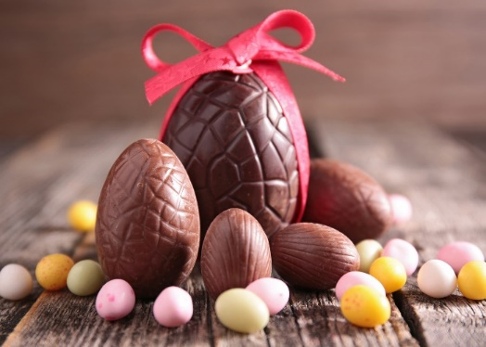
English – RE Week Yesterday we looked at how Christians show they belong to their religion.

Slide 20
Islam

Slide 21
Star and Crescent
The star and crescent symbol is the symbol most commonly associated with Islam. It has little to do with the actual faith and its origins are unclear.
The symbol used to be on the flag of the Ottoman Empire, which was the dominant Muslim power for nearly 700 years. It is now linked with Islam, but is not an official symbol of Islam.

Slide 22
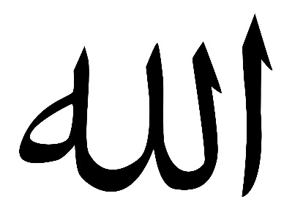

Slide 23
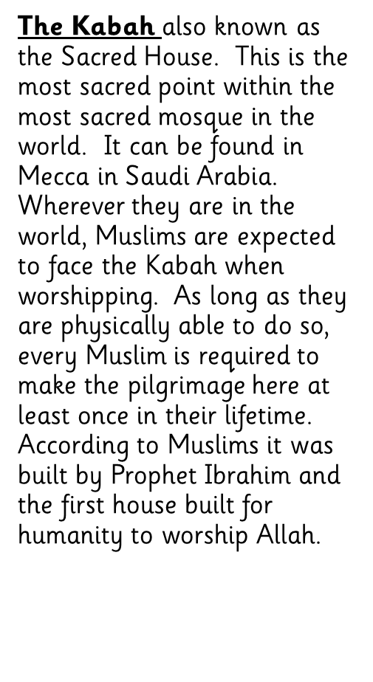
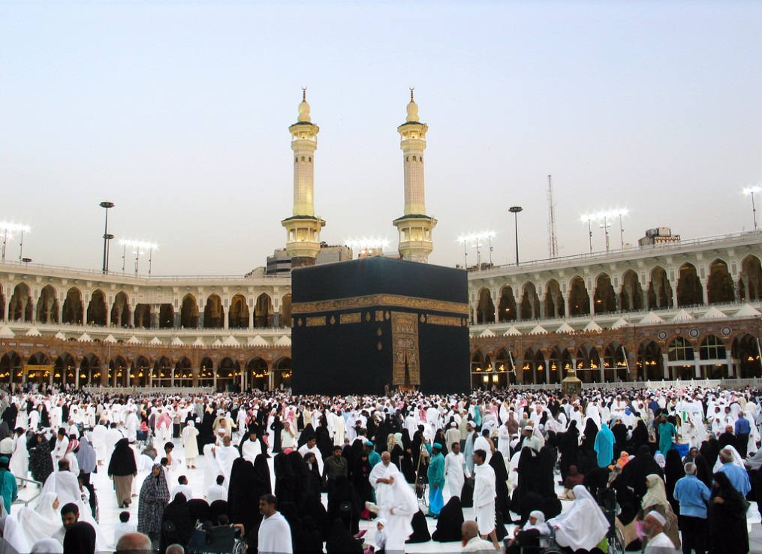
Photo courtesy of themua(@flickr.com) - granted under creative commons licence - attribution

Slide 24
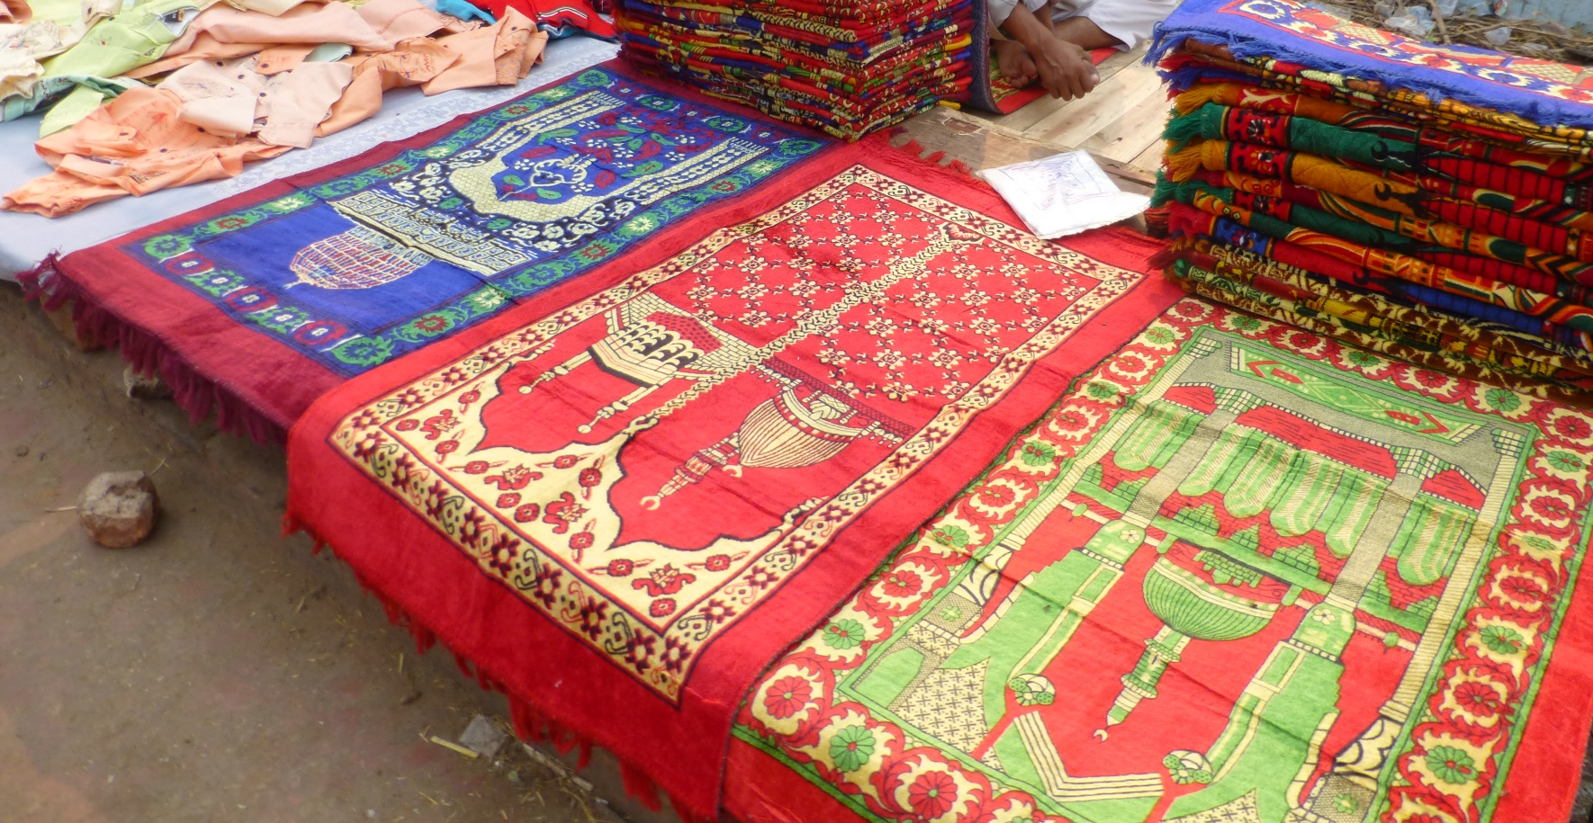
Photo courtesy of barspiller (@flickr.com) - granted under creative commons licence - attribution

Slide 25
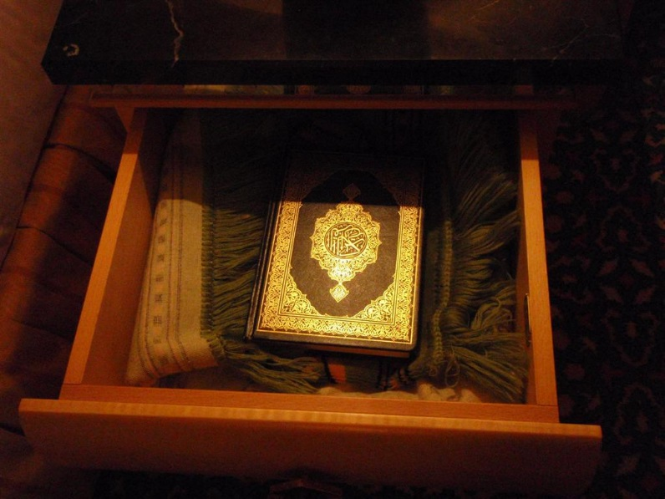
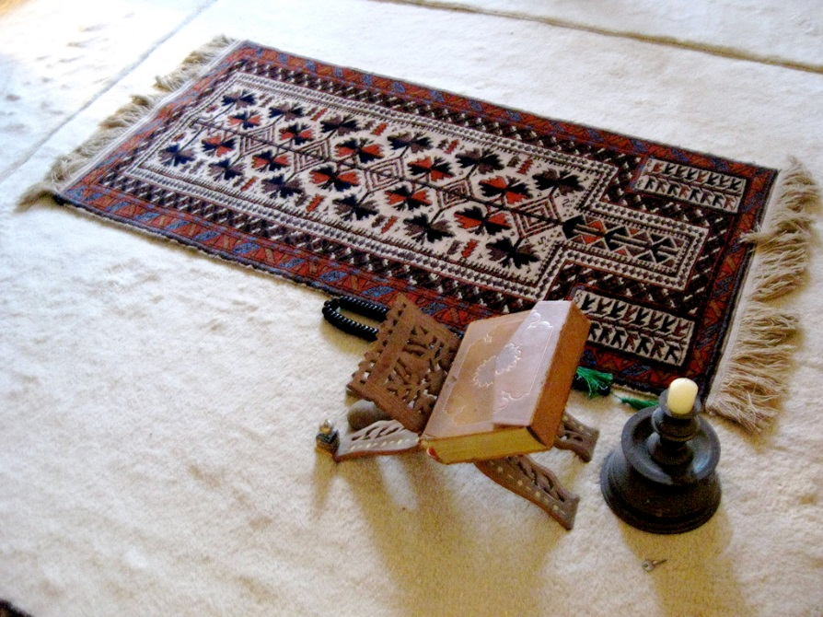
What is the Qur’an?
The Qur’an is the holy book for Muslims and is written in Arabic.
Muslims believe it is the perfect word of God.

Slide 26
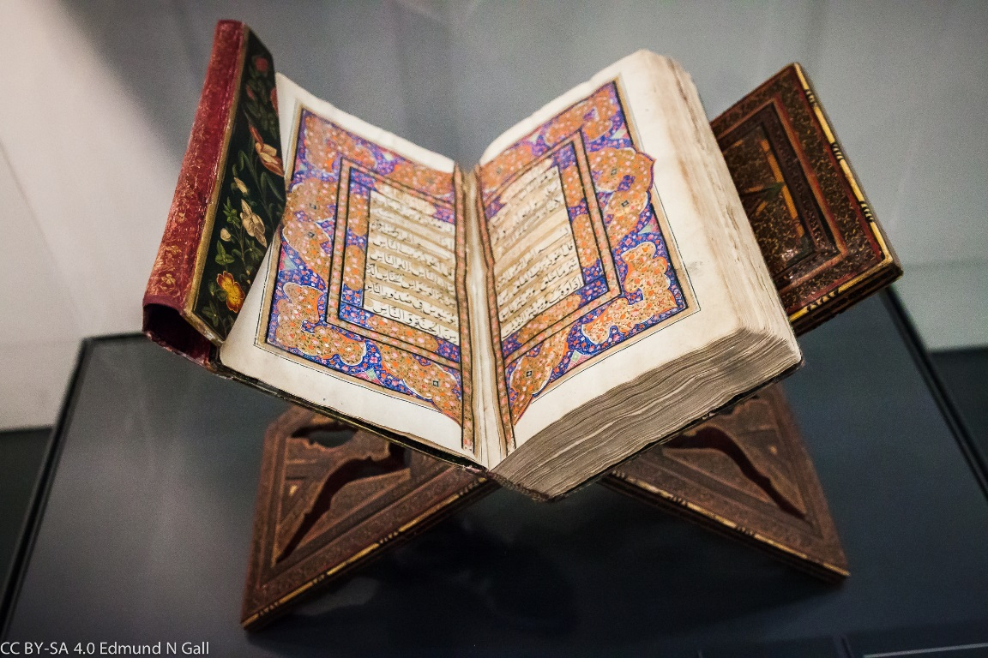
What is the Qur’an?
Muslims show respect for the Qur’an by washing their hands before touching it. When not being used, the Qur’an is often wrapped up in a special cloth and kept on a high shelf to show respect.
It must never touch the floor and is placed on a special stand when being read. Many Muslims around the world learn the Qur’an off by heart!

Slide 27
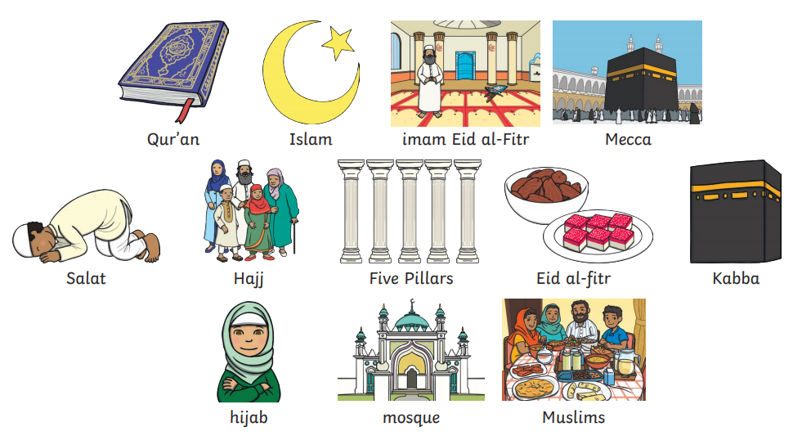

Slide 28
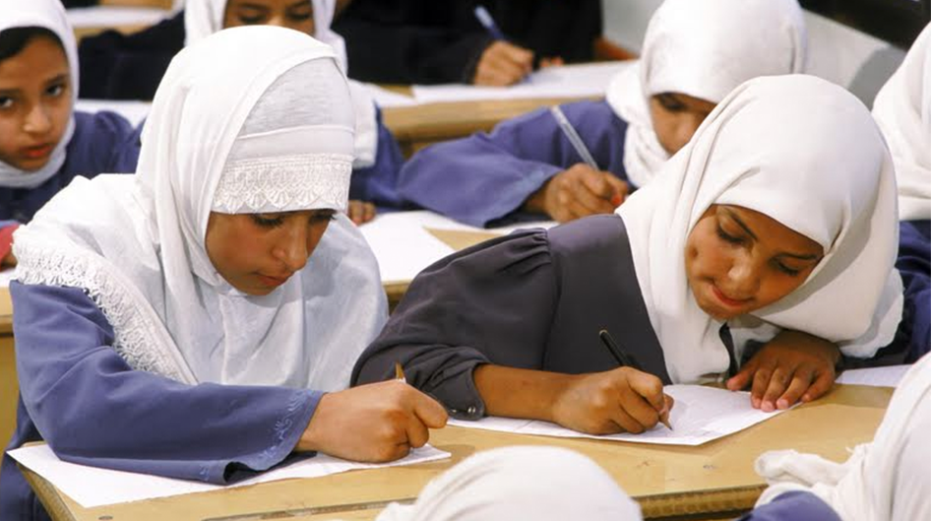

Slide 29
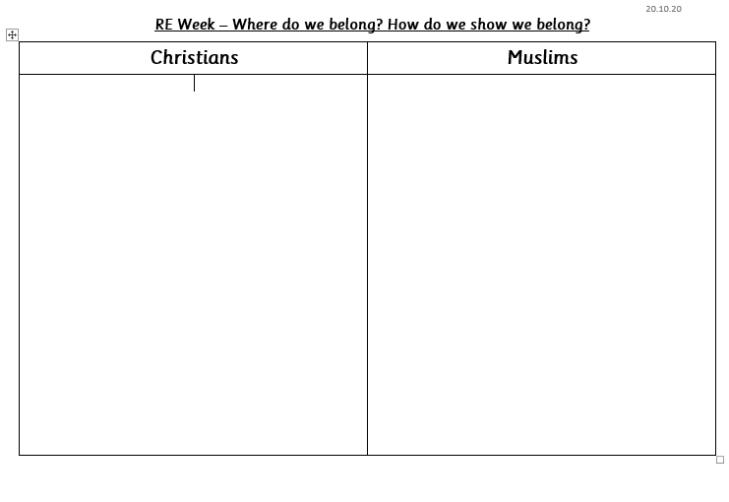
Complete the first column and write how Christians show they belong to their religion.

Slide 30
Big Idea – RE Week
A new baby:
Can pupils remember anything about being a baby, their first word, the first food they ate, etc?
Do pupils’ parents have mementoes of when they and their siblings were babies- such as framed scan images, photos, baby books, little hand or footprints? Why do parents keep these mementoes?
Talk about how when a new baby arrives it is a very special time- it is like a gift has been given to the family. We are going to learn about how a new baby is welcomes into religious groups.

Slide 31
Christianity – Welcoming a baby
Has anyone been to a Christening?
https://www.bbc.co.uk/bitesize/clips/zm87tfr
Do the class know what baptism will actually involve? How can we show something new and ex citing is about to start? Christians show it with water- symbolising a clean, fresh start. Watch this second clip where Jamie is baptised:
https://www.bbc.co.uk/bitesize/clips/zr34wmn
After watching the clip, talk about the water. How many times was water poured on Jamie’s head? 3- for the father, the son and the holy spirit, the three ways Christians understand God. You could also talk about the candle, symbolising the way a new baby is like a shining light.

Slide 32
Christening
A christening is when a baby is welcomed into the Christian faith. The baby’s parents and friends all go to a church service.
A person who leads a church is sometimes called a priest or a vicar.
At the start of the christening, the
vicar will welcome people to the
church and then read something from
the Bible.

Slide 33
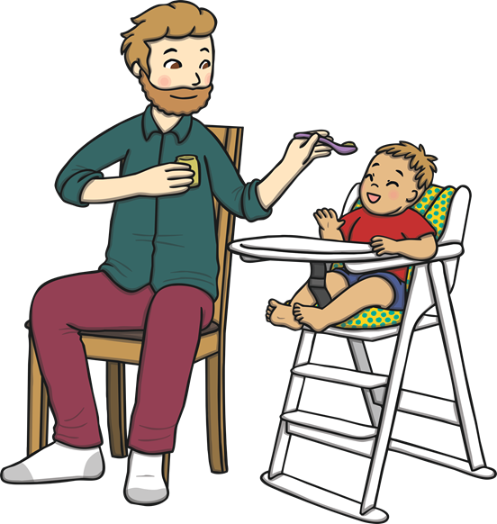
Godparents
Then, the parents and the baby will go and stand by the vicar along with some other people. They are called godparents.
Godparents are friends or family chosen by the baby’s parents. They make a promise to help the baby learn more about being a Christian.

Slide 34
The Sign of the Cross
Sometimes in a christening, the vicar will
dip their hand in some oil. They will then
move their hand in the shape of a cross
over the baby’s head.
The cross is special to Christians because they believe Jesus died on a cross.

Slide 35
The Font
Lots of churches have a font, which has water in it. The vicar will hold the baby’s
head over the font and then sprinkle the
baby with water.
The vicar will say the words: ‘I baptise
you in the name of the Father, and of
the Son and of the Holy Spirit.’
Talk About It
How do you think the baby feels when the water
is sprinkled?

Slide 36
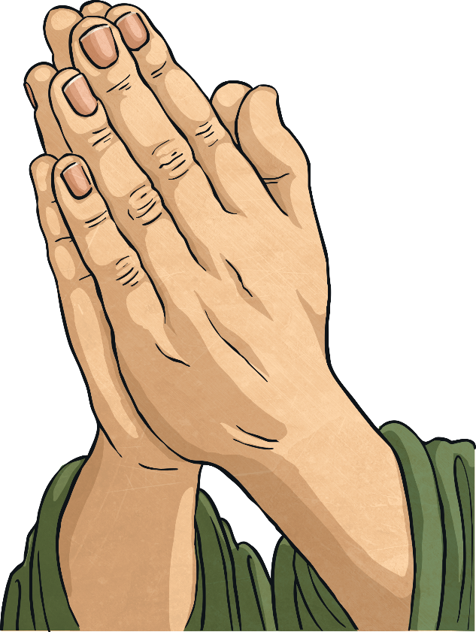
Prayers
Praying is talking to God. During the
christening, special prayers are said for
the baby.
Talk About It
If you were going to say a prayer for a baby, what
would you say?

Slide 37
A Candle
Sometimes at a christening, a special candle is lit. The vicar will say to the baby ‘Shine as a light in the world to the glory of God’.
A candle brings light to dark places. Can you think of ways that bad times could be made better, just like the light makes darkness go away?
Talk About It

Slide 38
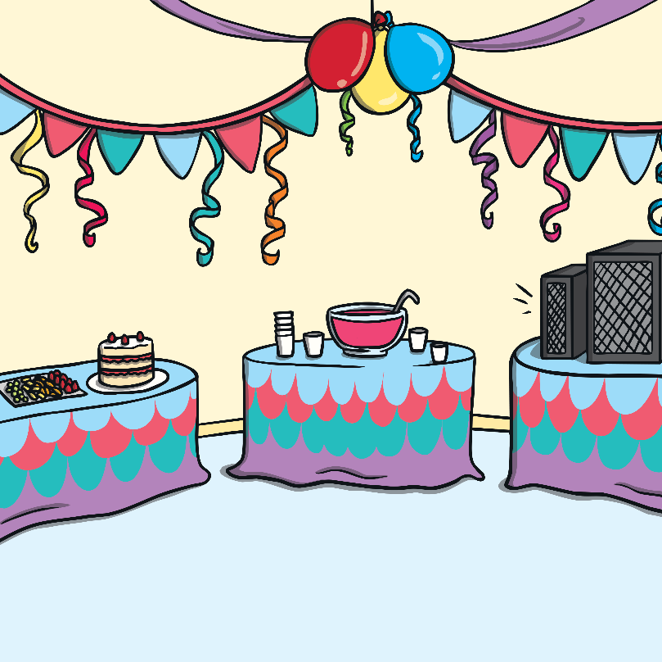
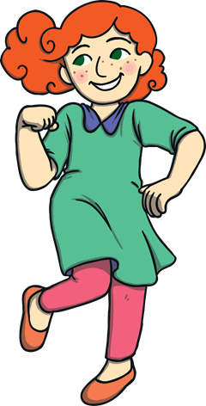
A Party
After the christening, family and friends might have a special meal or a party. It is a very happy time.
Talk About It
What special food would you have at a party?

