Slide 1
Learning for Monday 19th October
Year One

Slide 2
Early Bird Phonics
Write the sound buttons on these words
cow
fur
turn
now
curl
down
burn
gown

Slide 3
Maths – Maths in Minutes
https://www.topmarks.co.uk/learning-to-count/paint-the-squares
Can we count forwards to 100?
What happens to the numbers when we count forwards? Backwards?

Slide 4
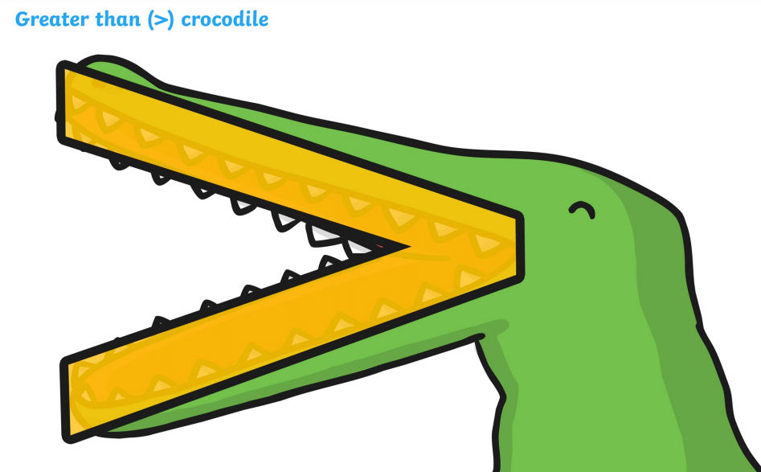
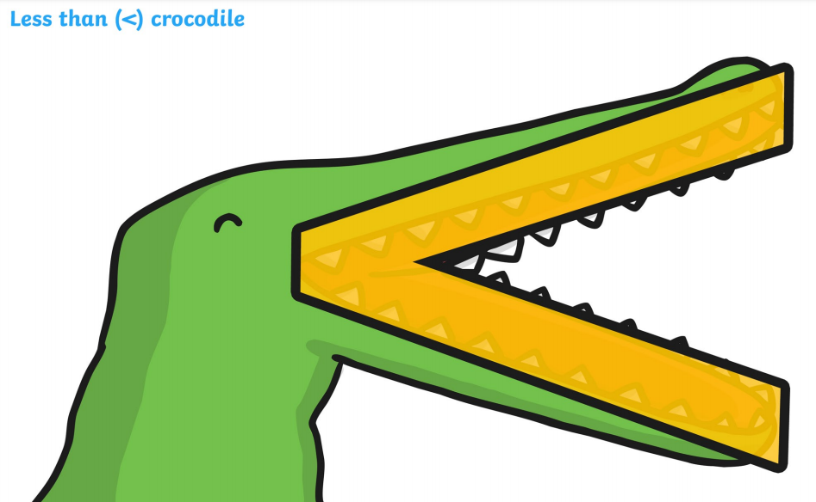
LO: To order numbers and objects, using the language of equal to, greater than and less than.
Maths
We have been looking at ‘greater than’ and ‘less than’. Use our crocodile signs to help you remember – the crocodile wants to eat the bigger number!

Slide 5
Fluency
Count then order the cherries from smallest to greatest.
5
3
4
3
4
5

Slide 6
Fluency
Count then order the bananas from smallest to greatest.
5
7
3
3
5
7

Slide 7
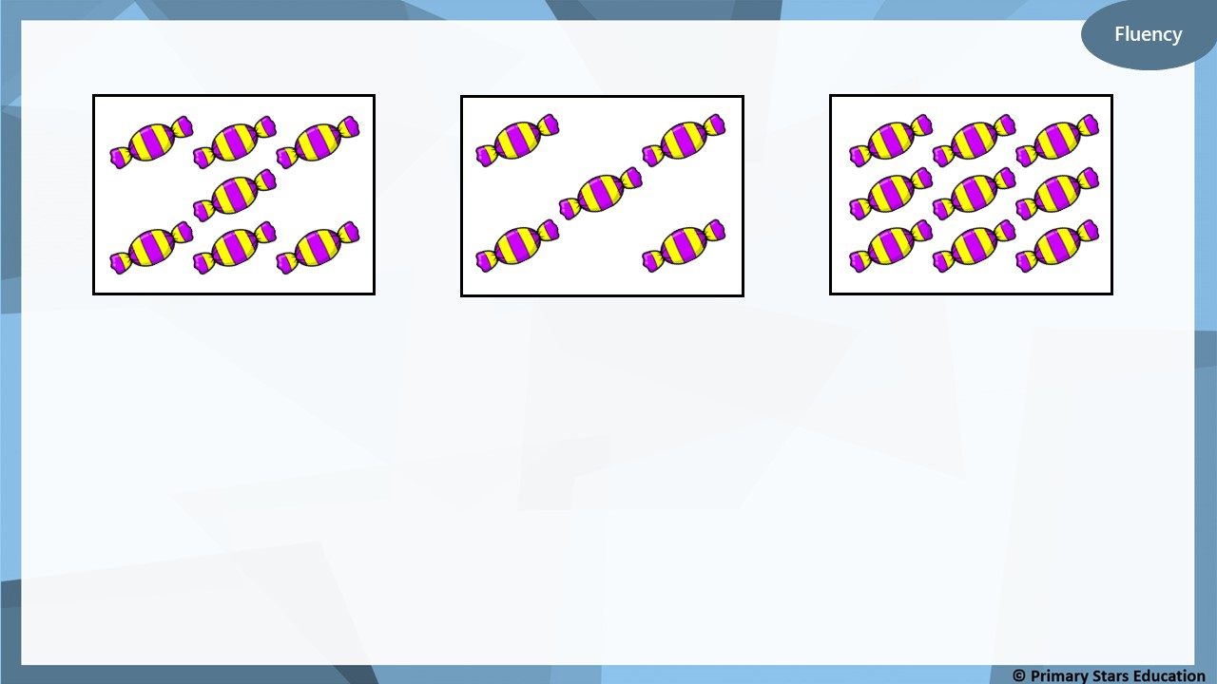
7
5
9
__________ sweets.
__________ sweets.
__________ sweets.
5
The smallest number of sweets is _______.
9
The greatest number of sweets is _______.

Slide 8
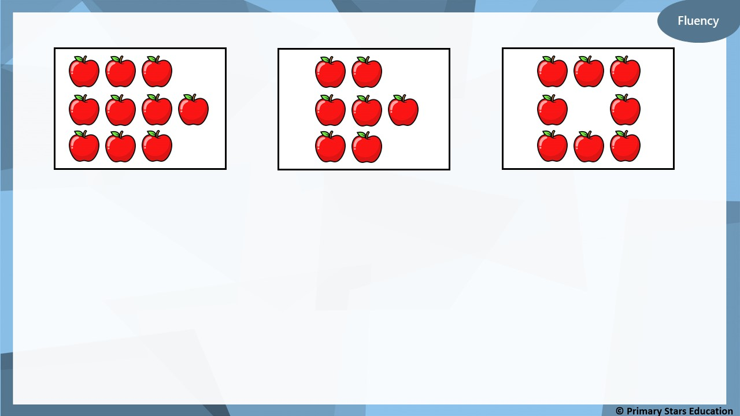
10
7
8
__________ apples.
__________ apples.
__________ apples.
7
The smallest number of apples is _______.
10
The greatest number of apples is _______.
For example:
10
7
7
10
_______ > _______ and _______ < _______.

Slide 9
The groups have been ordered greatest to smallest, The order is B, C, A.
True or false? Explain your answer.
False, from smallest to greatest it is A, C, B

Slide 10
The groups have been ordered smallest to greatest. How many doughnuts could go in the missing box?
How many different ways can you find?
7 doughnuts or 8 doughnuts.

Slide 11
See worksheet – Cut out the pictures and then order them from smallest to largest.
LO: To order numbers and objects, using the language of equal to, greater than and less than.
3 < 5

Slide 12
Phonics
Recap Phase 2 and 3 sounds
Phonics Play – Flashcards
Log in:
Username: school
Password: meadow

Slide 13
Revisit: Here are the sounds we learned last week.
ar or ur ow
What words can you think of that have these digraphs?

Slide 14
New sound of the day!
oi
Our new digraph is ‘oi’ like in ‘coin’.
You normally find this sound in the middle of a word.

Slide 15
oi
coin
join
soil
oil
foil
boil

Slide 16
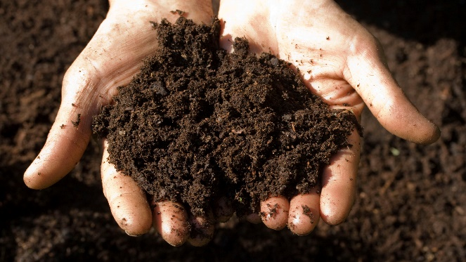
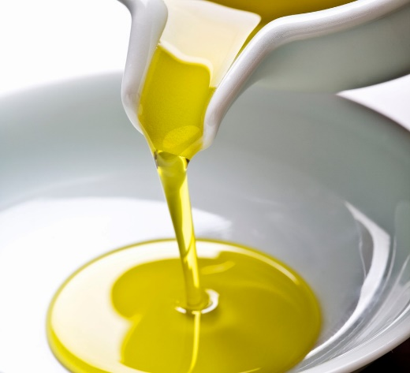
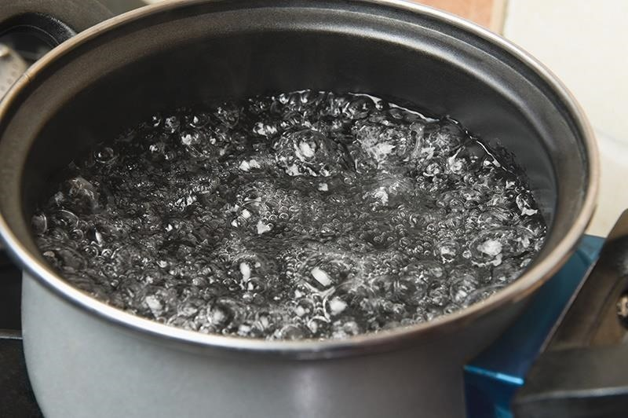
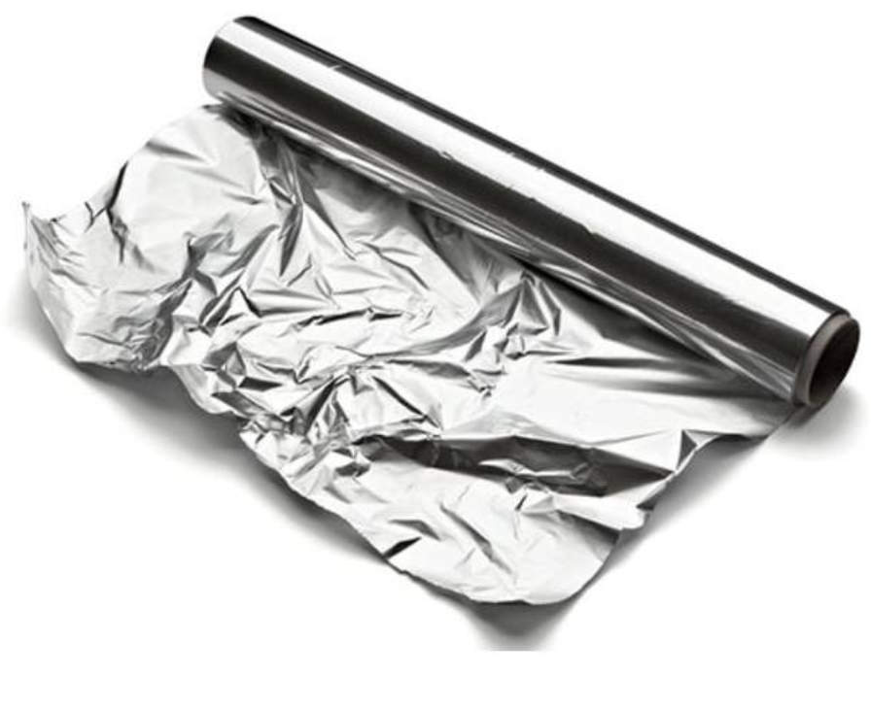
Write the words to match pictures. Challenge: Can you write the words in a sentence?
oi

Slide 17
English – RE Week Do we all belong to something?
Warm up game – ‘Would you rather…’ (be good at running or jumping, a deep sea diver or an astrocnaut, live in a castle or a campervan…’
If you belong, you feel safe.
Think of three things that make you who you are (hair colour, siblings, parents, skills).

Slide 18
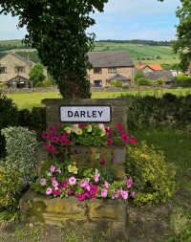
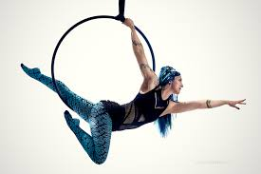
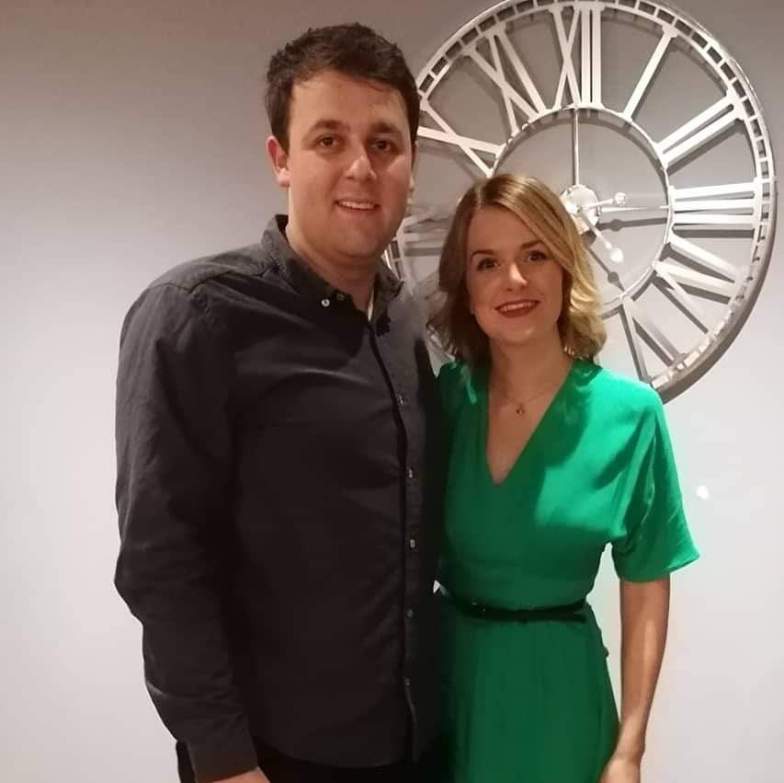
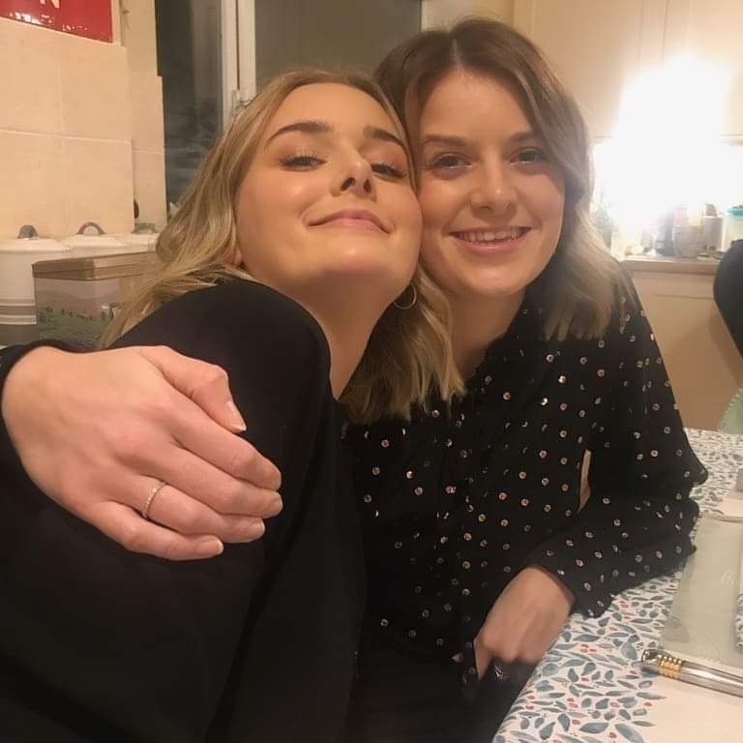
Who or what do I belong to?
Think about the people, places and groups you belong to.
These are the things I belong to:

