Slide 1
Learning for Friday 23rd October
Year One

Slide 2
Early Bird Phonics
What words can you write that begin with the letter ‘s’?

Slide 3
Maths
In Maths we have been looking at ordering numbers from smallest to greatest.

Slide 4
Maths – Ordering numbers
In Maths we have been looking at ordering numbers from smallest to greatest.
Roll the dice three times and write them down on a whiteboard.
Using the worksheet (on blog) write them down in the correct order.
smallest greatest

Slide 5
Phonics
Recap Phase 2 and 3 sounds
Phonics Play – Flashcards
Log in:
Username: school
Password: meadow
Tricky word song:
https://www.youtube.com/watch?v=R087lYrRpgY

Slide 6
Revisit: Yesterday we learned the ‘er’ digraph, like in ‘summer’.
er

Slide 7
ear
Read these words with the ‘er’ digraph:
summer
hammer
boxer
ladder
letter
dinner

Slide 8
New sound of the day!
ure
Our new trigraph is /ure/ like in ‘pure’
(Pronounced ‘your’

Slide 9
ure
Read these words with the ‘ure’ trigraph:
pure
mature
lure
secure
assure
manure
Write these words and add the sound buttons.

Slide 10
Buried Treasure: https://www.phonicsplay.co.uk/resources/phase/3/buried-treasure With the ‘ure’
ure

Slide 11
English – RE Week Yesterday we discussed the similarities and differences how Christians and Muslims welcome a baby into the world.
Today you are going to be writing about a traditional Christian Christening.
Watch this video to recap:
https://www.bbc.co.uk/bitesize/clips/zr34wmn
After watching the clip, talk about the water. How many times was water poured on Jamie’s head? 3- for the father, the son and the holy spirit, the three ways Christians understand God. You could also talk about the candle, symbolising the way a new baby is like a shining light.

Slide 12
Christening
A christening is when a baby is welcomed into the Christian faith. The baby’s parents and friends all go to a church service.
A person who leads a church is sometimes called a priest or a vicar.
At the start of the christening, the
vicar will welcome people to the
church and then read something from
the Bible.

Slide 13
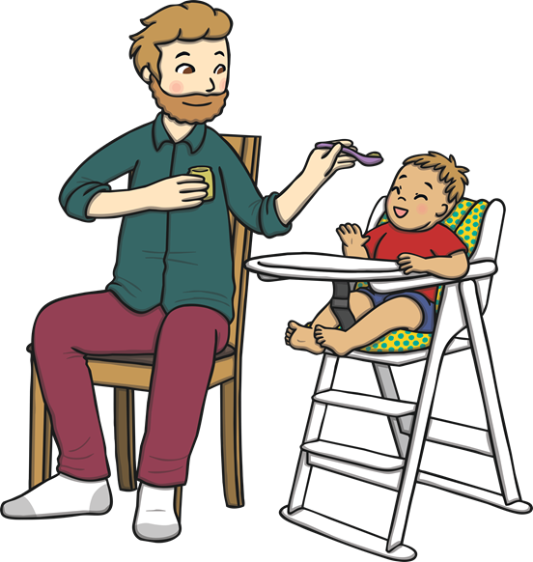
Godparents
Then, the parents and the baby will go and stand by the vicar along with some other people. They are called godparents.
Godparents are friends or family chosen by the baby’s parents. They make a promise to help the baby learn more about being a Christian.

Slide 14
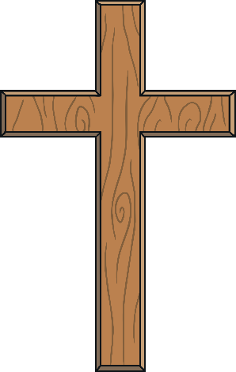
The Sign of the Cross
Sometimes in a christening, the vicar will
dip their hand in some oil. They will then
move their hand in the shape of a cross
over the baby’s head.
The cross is special to Christians because they believe Jesus died on a cross.

Slide 15
The Font
Lots of churches have a font, which has water in it. The vicar will hold the baby’s
head over the font and then sprinkle the
baby with water.
The vicar will say the words: ‘I baptise
you in the name of the Father, and of
the Son and of the Holy Spirit.’
Talk About It
How do you think the baby feels when the water
is sprinkled?

Slide 16
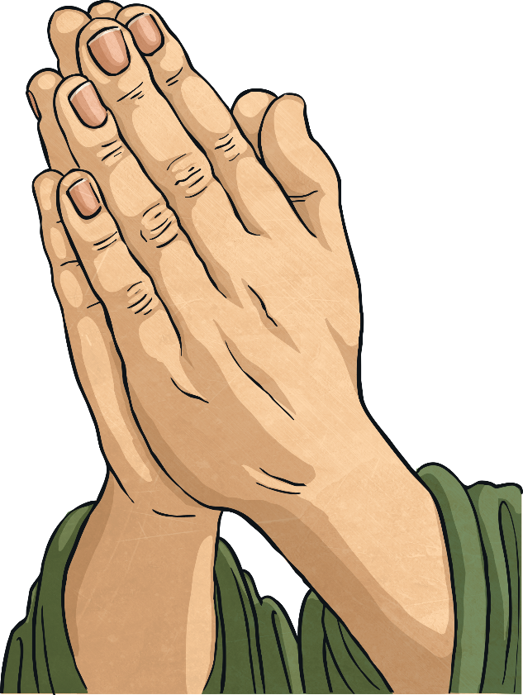
Prayers
Praying is talking to God. During the
christening, special prayers are said for
the baby.
Talk About It
If you were going to say a prayer for a baby, what
would you say?

Slide 17
A Candle
Sometimes at a christening, a special candle is lit. The vicar will say to the baby ‘Shine as a light in the world to the glory of God’.
A candle brings light to dark places. Can you think of ways that bad times could be made better, just like the light makes darkness go away?
Talk About It

Slide 18
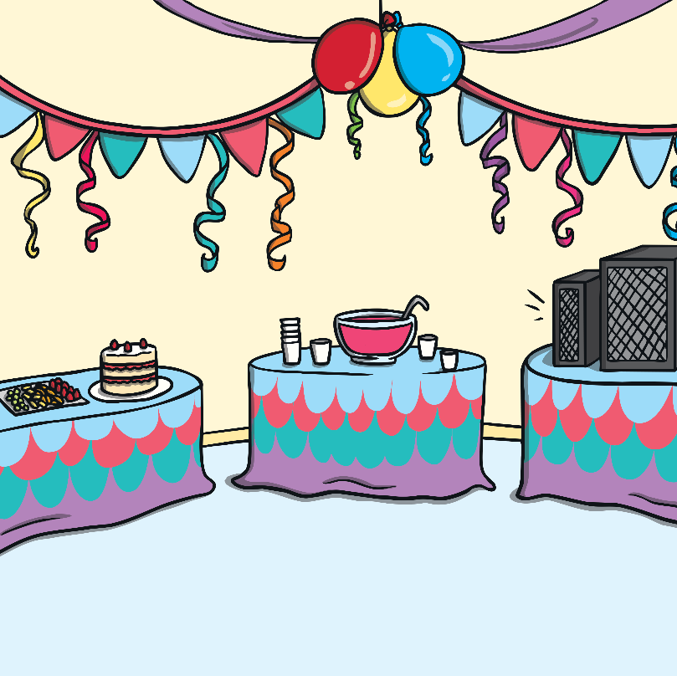
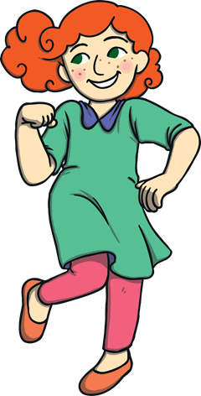
A Party
After the christening, family and friends might have a special meal or a party. It is a very happy time.
Talk About It
What special food would you have at a party?

Slide 19
Write down what happens at a traditional Christian Christening.
Here are your key words to help you:
Christening
God
Baby
Water
Vicar

